Slide 1

THE BUSINESS OF YOU:
10 STEPS FOR RUNNING YOUR CAREER LIKE A BUSINESS
@JonKruger

Slide 2

MISSION, VISION, VALUES
http://www.newyorker.com/online/blogs/photobooth/2013/05/slide-show-jimmy-chin-and-conrad-ankers-photographs-of-everest.html#slide_ss_0=12/

Slide 3
Mission… who are you?
Vision… where do you want to go?
Values… what things do you value?

Slide 4
Canadian Cancer Society
Mission
The Canadian Cancer Society is a national, community-based organization of volunteers whose mission is the eradication of cancer and the enhancement of the quality of life of people living with cancer.
Vision
Creating a world where no Canadian fears cancer.
Values
Quality - our focus is on the people we serve (cancer patients, their families, donors, and the public) and we will strive for excellence through evaluation and continuous improvement.
Caring - we are committed to serving with empathy and compassion.
Notes:
Example

Slide 5

GOALS
http://www.earthporm.com/photoshop-10-amazing-places-wont-believe-arent-artificial/

Slide 6
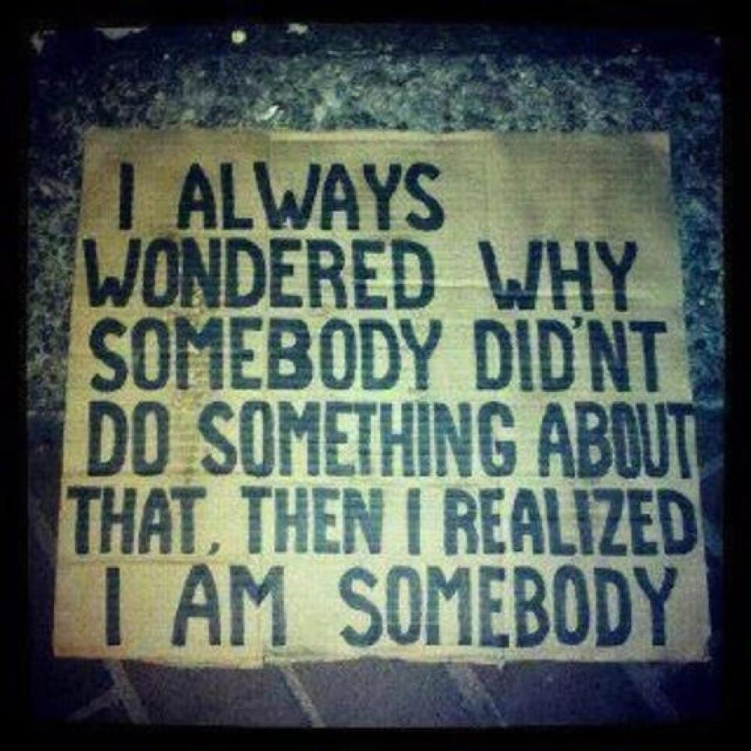
TAKE OWNERSHIP OF YOUR LIFE
http://megandagata.wordpress.com/2012/06/13/take-ownership/

Slide 7

FIND YOUR VALUE PROPOSITION
http://www.rontravel.com/travel_photo_pages/pictures_china_siberia_happy_cannibal.htm

Slide 8
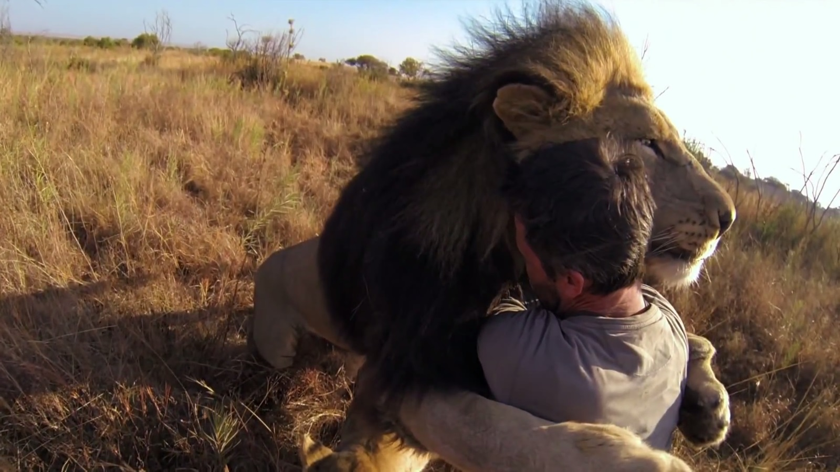
MAKE TIME FOR PEOPLE
http://www.earthporm.com/man-tries-hug-wild-lion-wont-believe-happens-next/

Slide 9

EXPERIENCE IS IRRELEVANT.
ACCOMPLISHMENTS ARE EVERYTHING.

Slide 10

LEARN FROM “FAILURES”

Slide 11
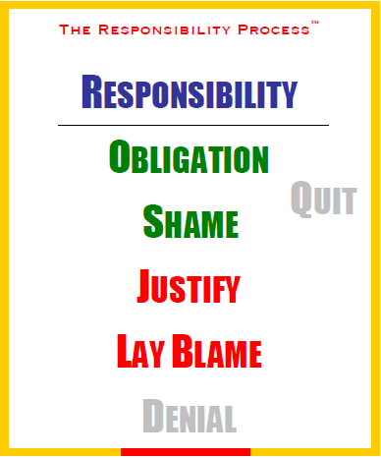
Source: Christopher Avery
http://www.christopheravery.com/responsibility-poster

Slide 12

BE CONFIDENT
http://www.earthporm.com/photoshop-10-amazing-places-wont-believe-arent-artificial/

Slide 13

BULLIES

Slide 14
You are responsible for your life and career

Slide 15
"Don't ask yourself what the world needs. Ask yourself what makes you come alive and then go do that. Because what the world needs is people who have come alive.”
-- Howard Thurman

Slide 16

Resources
Leon Gersing – “You”
google: “leon gersing you keynote”
http://www.davidgiard.com/2012/05/11/GANG10KeynoteLeonGersingOnYou.aspx

Slide 17
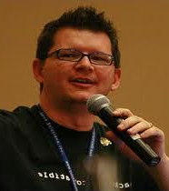
Resources
Brian Prince –
“Driving Your Career”
google: “Brian Prince driving your career”
http://www.brianhprince.com/2010/04/14/driving-your-career-series-transcripts/

Slide 18

Resources
The Passionate Programmer,
by Chad Fowler

Slide 19

Resources
Good to Great, by Jim Collins

Slide 20
Thanks!
Slides:
http://jonkruger.com/,
click on Presentations
Email: jon@jonkruger.com
Twitter: @JonKruger
Blog: http://jonkruger.com

